Slide 1
CANDLE Tutorial: CANDLE Overview + Motivating Examples
Arvind Ramanathan

Slide 2
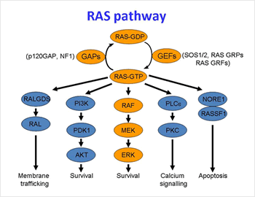
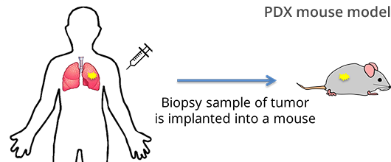
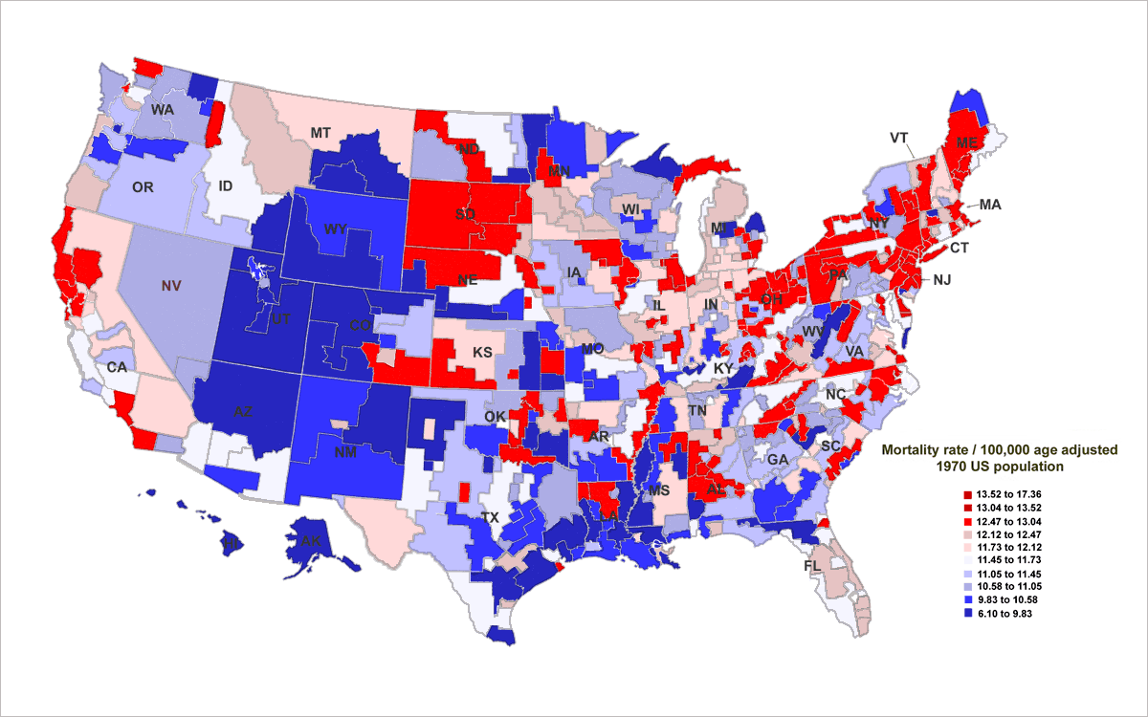
NCI-DOE Partnership: Extending the Frontiers of Precision Oncology (Three Pilots)
Cancer Biology
Molecular Scale Modeling of RAS Pathways
Unsupervised Learning and Mechanistic models
Mechanism Understanding and Drug Targets
Pre-clinical Models
Cellular Scale PDX and Cell Lines
ML, Experimental Design, Hybrid Models
Prediction of Drug Response
Cancer Surveillance
Population Scale Analysis
Natural Language and Machine Learning
Agent Based Modeling of Cancer Patient Trajectories

Slide 3
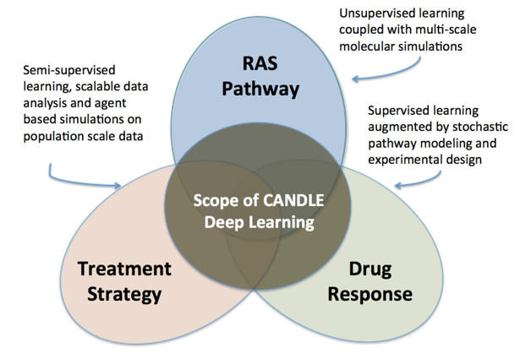











ECP-CANDLE: CANcer Distributed Learning Environment
CANDLE Approach
Develop an exscale deep learning environment for cancer
Build on open source deep learning frameworks
Optimize for CORAL and Exascale platforms
Support all three pilot project needs for deep dearning
Collaborate with DOE computing centers, HPC vendors and ECP co-design and software technology projects
3

Slide 4
Learning Objectives / Outline
Differences between traditional machine learning (ML) and deep learning (DL) techniques (15 minutes):
A practitioner’s perspective on ML and DL/AI
CANDLE Challenge problems and descriptions (25 minutes):
What does a CANDLE workflow entail?
Example problems and approach
Some initial code runs with real datasets
Capabilities and Ongoing Research (10 minutes):
Large-scale data and model parallelism
Distributed Hyperparameter optimization

Slide 5
Traditional ML vs. DL
A practitioner’s perspective on the differences between ML and DL
Where does the computational complexity of DL arise from?

Slide 6
Traditional machine learning paradigm
Gather as much labelled data as possible
Throw some at it …
Pick the best functioning algorithm
Spend hours hand encoding features:
run feature selection/ model selection/ dimensionality reduction/ other techniques
Repeat…

Slide 7
But, what is machine learning?
According to Tom Mitchell (CMU) ”ML deals with construction and study of systems that learn from data”
A computer program is said to learn from experience (E) with respect to some class of tasks (T) and performance at tasks in T, as measured by P, improves with experience E

Slide 8
What is machine learning?
Traditional paradigm:
Machine learning:
Data
Computer
Output
Program
Data
Computer
Program
Output

Slide 9
A simple perceptron
x₁
x₂
x₃

Slide 10
Can a simple perceptron learn?
Example: XOR
Exclusive OR
[x₁, x₂]^{T}
y = 1 only when one of x₁ or x₂ is 1
X = {[0,0]^{T}, [0,1]^{T}, [1,0]^{T}, [1,1]^{T}}
Y = {0, 1, 1, 0}
X1 | X2 | Y
0 | 0 | 0
0 | 1 | 1
1 | 0 | 1
1 | 1 | 0

Slide 11
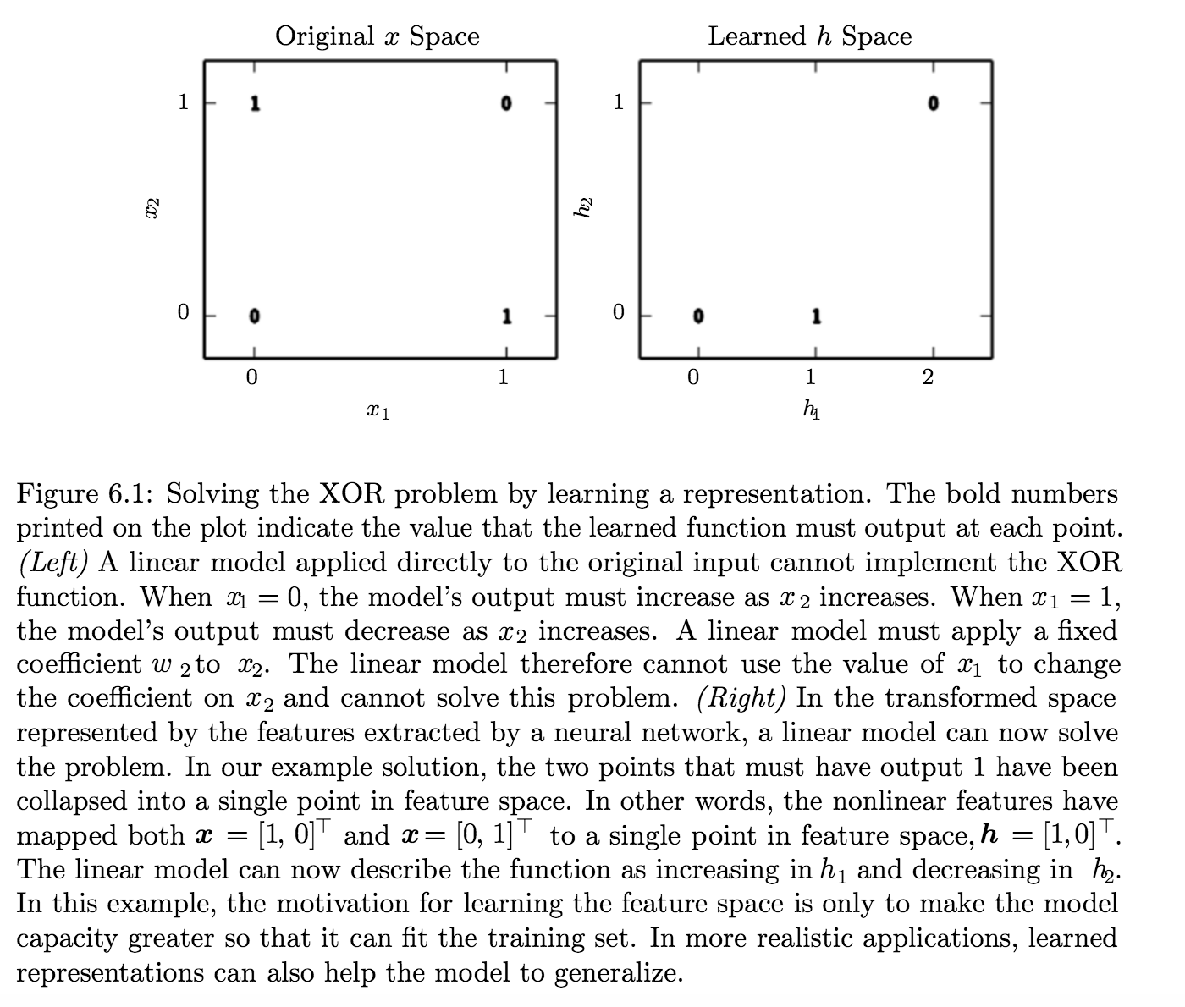
Traditional machine learning
Can we build a classifier?
Parameters for ?
Let’s choose a linear model
data
model

Slide 12
Linear features may not be best for capturing relationships in datasets
We output ½ everywhere!
Linear features are not good for XOR
We need other ways to solve this:
Two applications of a function in a chain …
What does h do?

Slide 13
How does this perceptron look like?
y
Linear models will still be problematic
Neural networks use an affine transformation controlled by learned parameters followed by a non-linear function called activation function
g is referred to as a rectified linear unit (ReLU) defined by
h₁
h₂
x₁
x₂

Slide 14
Learning “XOR” with neural nets

Slide 15
Neural nets: all we need to know
Typically modeled using a ”neuron like model”
Activation functions can be many types, but only one can be applied to the neuron at hand!

Slide 16
Types of activation functions…

Slide 17
How to train a neural network?
Activation function is non-linear!!!
Gradient descent can be used to train neural network

Slide 18
Forwardprop and Backprop!
Compute gradient of example-wise loss wrt parameters
Computing loss function is O(n) computation

Slide 19
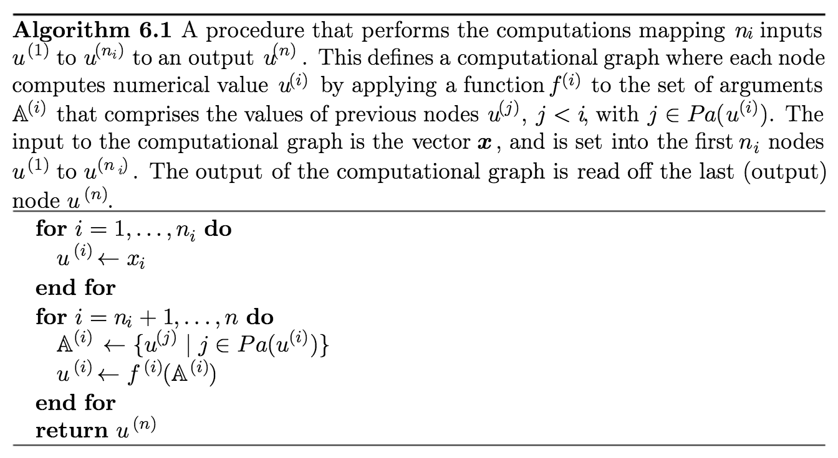
ForwardProp: compute output based on the neural network

Slide 20
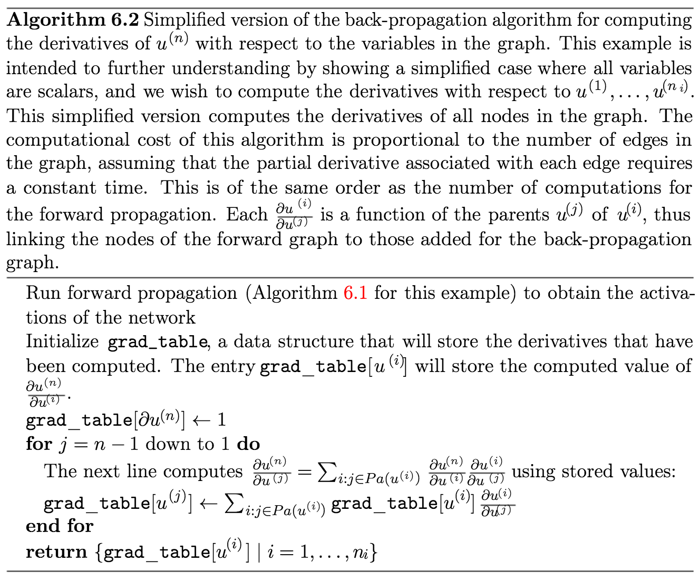
Backprop Algorithm: propagate errors wrt model and data

Slide 21
Backprop can be generalized…
Backprop can be generalized beyond the scalar case
then, computing the error is nothing but:

Slide 22
The decision boundary perspective…
Initial random weights

Slide 23
The decision boundary perspective…
Present a training instance / adjust the weights

Slide 24
The decision boundary perspective…
Present a training instance / adjust the weights

Slide 25
The decision boundary perspective…
Present a training instance / adjust the weights

Slide 26
The decision boundary perspective…
Present a training instance / adjust the weights

Slide 27
The decision boundary perspective…
Eventually ….

Slide 28
Deep Learning
Hierarchical, Generalizable:
and can be unsupervised
Efficient, Sharable, Distributed
Downsides:
Blackbox
Training time?
How much data?

Slide 29
CANDLE Workflows and Challenge Problems
Some working deep learning terms/ terminology
Challenge problems
CANDLE Workflows
A practical example of clustering biomolecular simulations into conformational states

Slide 30
CANDLE vs. other ECP Applications
CANDLE supports large-scale deep learning workflows:
Goal is to enable massive throughput for:
Data pre-processing,
Model search, training, and inferencing
Post-processing
Provide the necessary compute infrastructure that enables massive throughput on emerging Exascale architectures:
Support data parallel and model parallel paradigms for efficient use of resources
Enable hyperparameter searches over large/ complex models
Build on open source platforms that are optimized for CORAL architectures and beyond
Enable practical feedback between simulations/ experiments

Slide 31
A practical walk-through of developing a deep learning model

Slide 32
A general deep learning workflow
Data Pre-processing
Model Discovery
Training Phase
Steps to allow data to be ingested by the ML/DL algorithm
Transform data into some initial representation
[Not feature extraction]
Discover a subset of neural network architecture that obtains reasonable task-specific performance
“learning to learn”
Optimize the neural network for task-specific performance
Can be classification, clustering, multi-task learning …
Hyper-parameter Optimization
Performance analysis across models
Feature importance
Sensitivity analyses
Cross-validation
Ensembling, Boosting/ Bagging, etc.
Inference rationalization
“how did the model arrive at some X”
Post-processing/ Outputs
Inference
Uncertainty Quantification (UQ)

Slide 33
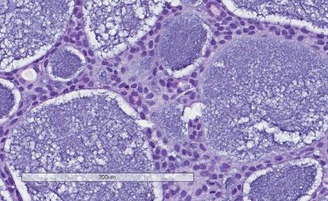
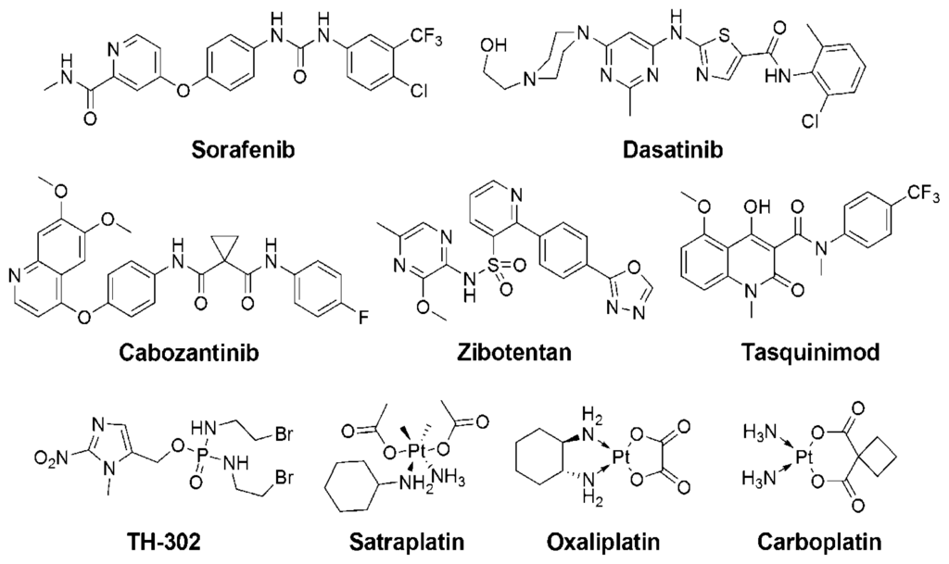
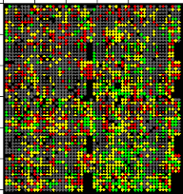
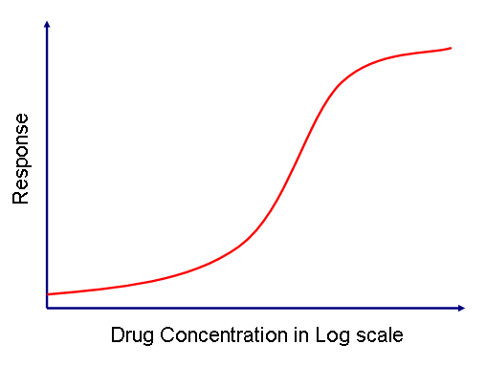
Example Pilot 1 problem: Modeling Cancer Drug Response
Drug (s)
Models vary in {Samples, Drug or Drug Combinations, One or More Studies, Explicit or Implicit Dose, Growth (%, Categorical Response, Time for Doubling)}
Models vary in features used to characterize Samples and Drugs {GE, SNP, Descriptors, Fingerprints}
We search machine learning methods (DNN, RF, GB, BMTMK, LightGBM, etc.) and compare them
Goal is is maximizing Model Accuracy, Generalizability and Transferability
Single Study (N Sample x Single Drug) One Model per Drug (M_{Dn}) ⟹ {Robot, RF, many models}
Single Study (N Samples x Drug Pairs) One Model per Drug Pair (M_{Pn}) ⟹ {RF, BMTMK}
Single Study (N Samples x Drug Pairs) One Model per Study (M_{P}) ⟹ {COMBO, RF}
Single Study (N Samples x Single Drug and Drug Pairs ) One Model per Study (M₊) ⟹ {UNO}
M Studies (M*(N_{m} Samples x Single Drug)) One Model per All Studies (M*) ⟹ {Uno, Robot, Bres, RF}
M Studies (M*(N_{m} Samples x Single Drug and Drug Pairs)) One Model per All Studies (M₊*) ⟹ {UNO}
descriptors
fingerprints
structures
SMILES
dose
→
𝓡 = 𝑓(𝓣, 𝓓)
𝓡 = 𝑓(𝓣, 𝓓₁ , 𝓓₂)
→
→
IC50
GI50
% growth
Z-score
gene expression levels
SNPs
protein abundance
microRNA
methylation
Increase in computational complexity
Response
Tumor

Slide 34
P1 Challenge Problem Workflow(s) Specification
Data Preparation
Data Augmentation
Batch Normalization
Outlier Removal
Scaling/Quantization
Concordance Processing
Training
Inference
Ensembles
Source – Target Pairs
Drug Combinations
Domain Adaptation
Confidence Scoring
Cross-validation
Model Discovery
Residual Networks
Multitask Networks
Population Based HPO
Convolution
Transfer Learning
Outputs
UQ
Accuracy / K-rank / R²
Factorial Design
Feature importance
Learning Curves
Performance Analysis

Slide 35
P1 Challenge Problem Workflow(s) Specification
Data Preparation
Data Augmentation
Batch Normalization
Outlier Removal
Scaling/Quantization
Concordance Processing
Training
Inference
Ensembles
Source – Target Pairs
10⁶ – 10⁸
^{units of work}
Drug Combinations
Domain Adaptation
Confidence Scoring
Cross-validation
Model Discovery
Residual Networks
Multitask Networks
Population Based HPO
Convolution
10⁵ – 10⁶
^{units of work}
Transfer Learning
Outputs
10⁵ – 10⁶
^{units of work}
UQ
Accuracy / K-rank / R²
Factorial Design
Feature importance
Learning Curves
Performance Analysis

Slide 36
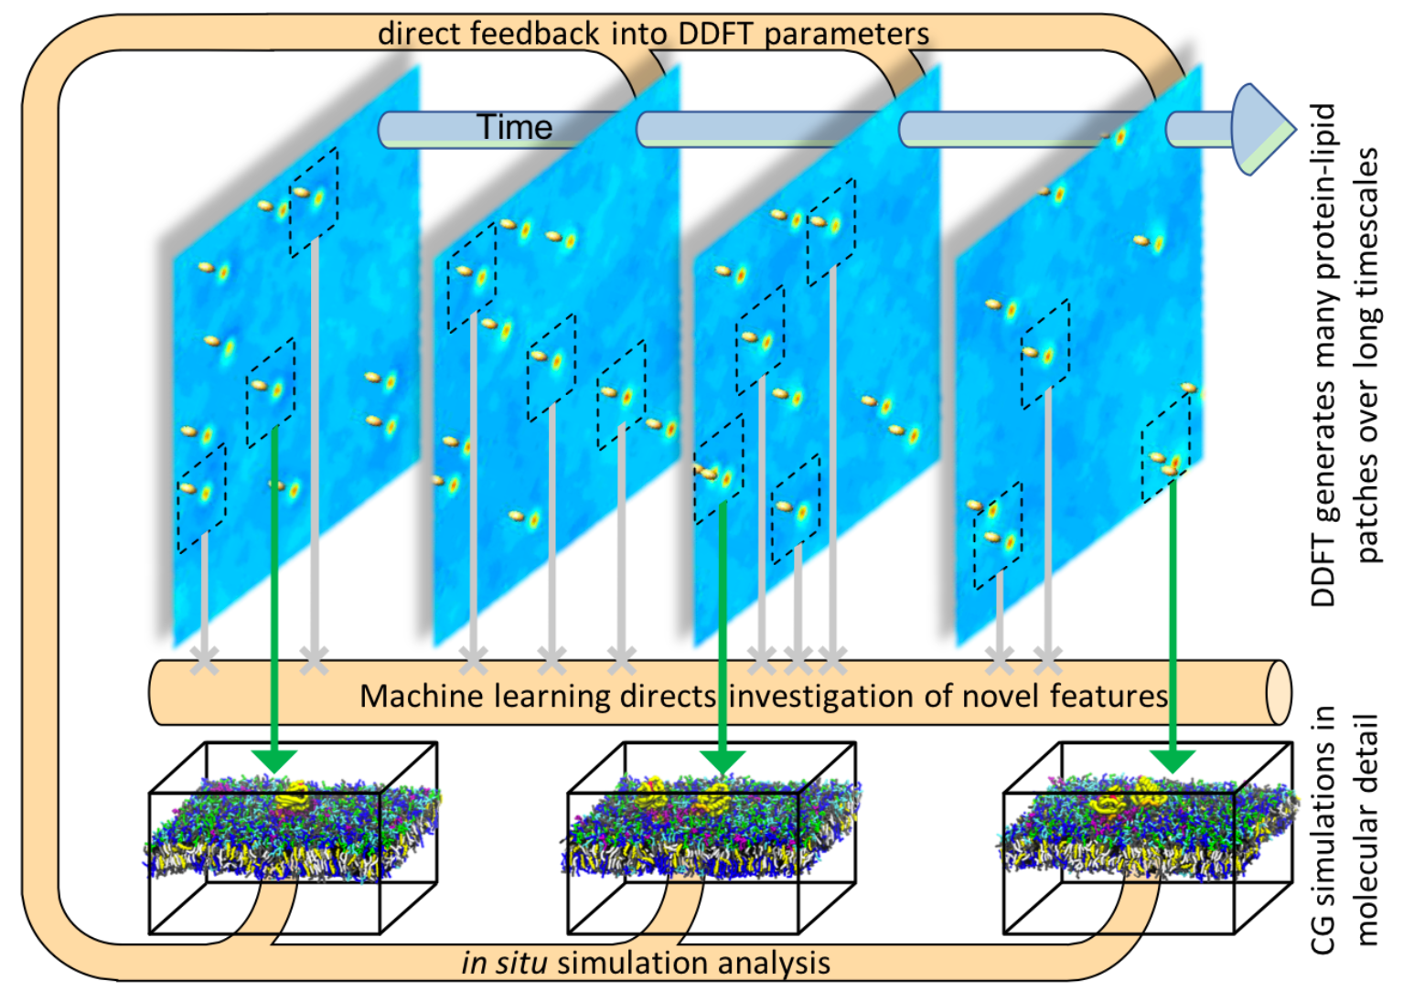
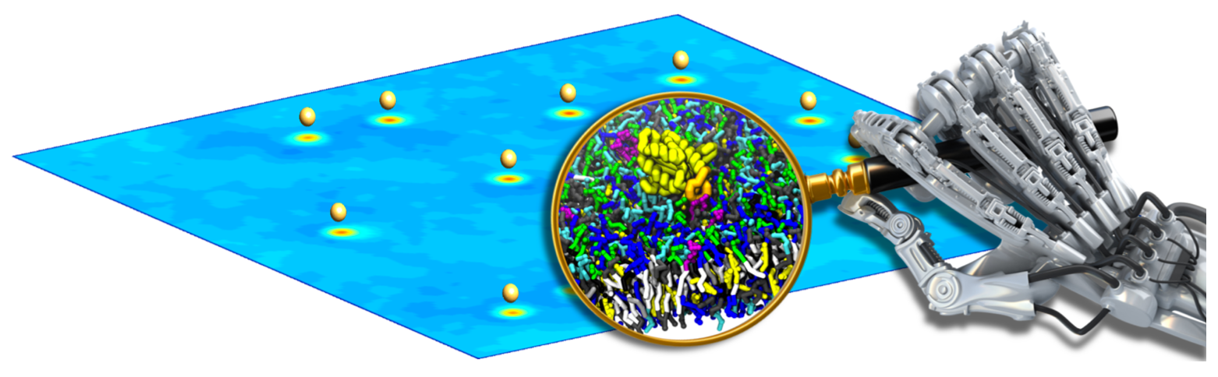
Pilot 2 – Detecting interesting RAS / RAF binding
Identify when the binding event is occurring within the simulation
Classify the state of the binding as normal or anomalous
Allow researchers to watch the evolution of the binding to find new methods for intervention
Notes:
Lipid cluster detection
Find anomalous bindings of multiple proteins to lipid membrane
Classify state of multiple protein configurations

Slide 37
P2 Challenge Problem Workflow(s) Specification
Data Preparation
Generate graph patterns for protein confirmations
Neighborhood-based frame encoding of Coarse-Grained MD Sim
Training
Inference
Each frame of each simulation
Ensemble
Across multiple simulations
Model + Data Parallel
Model Discovery
Neighborhood-based molecular Autoencoders
Multi-protein CVAE + neighborhood projection network
Supervisor HPO
Temporal cluster detection Recurrent Neural Networks
Outputs
Large-scale data ingestion
Binding state
prediction
In-situ w.r.t. simulation
Range of interesting frames

Slide 38
Pilot 3: Treatment Strategy Problem
DL NLP Models
Single and Multi-task Convolutional Neural Networks
Attention + Convolutional Networks
Other models
NLP algorithmic innovation
Scalability across pathology labs, SEER registries, & phenotypes
Supervised
Development & deployment of product
Cancer Phenotypes
Site
Histology
Grade
Behavior
Laterality
…..
API
Semisupervised
Increasing level of model complexity
Embeddings
Word2Vec
CUI2Vec
Other models
FastText
Unsupervised
257,040 cancer phenotypes observed in 4 SEER registries (CTC records) based only on 5 attributes
70 cancer sites (306 subsites); 515 histologies; 9 grades; 7 lateralities; 4 behaviors
Extension to other NLP tasks to extract more data elements (e.g., biomarkers) will increase the number and complexity of cancer phenotypes observed – combinatorial explosion in computational cancer phenotyping → Exascale computing

Slide 39
P3 Challenge Problem Workflow(s) Specification
Data Preparation
Word2Vec
CUI2Vec
Other models
FastText
Data Preparation
Word2Vec
CUI2Vec
Other models
FastText
Training
Training
Inference
Inference
Retrospective analysis: Batch level inference
Retrospective analysis: Batch level inference
Ensemble
Ensemble
Prospective analysis: per-document inference
Prospective analysis: per-document inference
Cross-validation
Cross-validation
Model Discovery
Single and Multi-task Convolutional Neural Networks
Attention + Convolutional Networks
HyperSpace HPO
Hierarchical Recurrent Neural Networks
Model Discovery
Single and Multi-task Convolutional Neural Networks
Attention + Convolutional Networks
HyperSpace HPO
Hierarchical Recurrent Neural Networks
Outputs
Outputs
UQ
UQ
Accuracy (classification)
Accuracy (classification)
Cheap to evaluate
Co-training
Co-training
Inference rationalization
Inference rationalization

Slide 40
CANDLE Challenge Problem Workflow Structure
Each challenge problem has three compute intensive phases and two data processing phases
Prepare input datasets, including normalization, outlier removal, joins and merges, etc.
Broad search of model space (AutoML+HPO) to find good performing model structures and hyper-parameter settings ⟹ running O(10⁴) – O(10⁶) model instances (HPO model selection ⟹ small number of model templates < 10 )
Training a large-scale ensemble of the best model types on relevant training data for a “factorial study” ⟹ O(10⁶) models on O(10⁴) datasets ( 5x cross validation and optional bootstrap UQ) (CV model selection ⟹ small number of models < 10 per Source-Target pair)
Inferencing with selected models with UQ on new samples (O(10⁷) in (and out) of each Source-Target Pair distributions (UQ implies sampling model space O(10²) times)
Post-process inference output for actionable decisions and to capture performance, confidence and scoring (for validation)

Slide 41
Example FOM Calculation
Titan Nodes ~ 18,688 A21 Nodelets ~ 94,000
P1 unit 60 hrs to train on Titan, 24/60 * 18,688 = 7,475 u/day
P1 unit 4 hrs to train on A21 “nodelet”, 24/4 * 94,000 = 564,000 u/day
P1 Ratio = 564,000 / 7,475 = 75.45x
P2 unit 6 hrs to train on Titan, 24/6 * 18,688 = 74,752 u/day
P2 unit 0.5 hrs to train on A21 “nodelet”, 24/0.5 * 94,000 = 4,512,000 u/day
P2 Ratio = 4,512,000/ 74,752 = 60.36x
P3 unit 12 hrs to train on Titan, 24/12 * 18,688 = 37,376 u/day
P3 unit .25 hrs to train on A21 “nodelet”, 24/0.25 * 94,000 = 9,024,000 u/day
P3 Ratio = 9,024,000 / 37,376 = 241.43x
H_{titan} = H_{a21} =
H_{a21} / H_{titan} = FOM = vs Mean[75.45, 60.36, 241.43] = 125.747

Slide 42
Walk-through of a practical example of identifying conformational states from MD simulations

Slide 43
Capabilities and Ongoing Research
HyperSpace: Distributed Bayesian Hyperparameter optimization
Supporting data parallel and model parallel runs with CANDLE

Slide 44
Current platforms for hyperparameter optimization rely on sequential optimization techniques
HyperSpace: Distributed Parallel Bayesian Optimization
Bayesian optimization, Bandit optimization, and others are usually sequential search processes
Exponential scaling:
The number of samples required to bound our uncertainty about the optimization procedure is scales exponentially with the number of search dimensions, as in 2^{D}, where D is number of dimensions [1, 2].
Forgotten in the recent excitement of Bayesian optimization.
Hyperspace, instead seeks to focus on the search space:
Parallelism to exploit the statistical structure of the search space
Reveal partial dependencies across parameter spaces
Build many surrogate functions in parallel
{Prayer}!
N. Srinivas, A. Krause, S. M. Kakade, and M. W. Seeger. Gaussian process bandits without regret: An experimental design approach. CoRR, abs/0912.3995, 2009.
S. Grunewalder, J.-Y. Audibert, M. Opper, and J. Shawe-Taylor. Regret Bounds for Gaussian Process Bandit Problems. In AISTATS 2010 - Thirteenth International Conference on Artificial Intelligence and Statistics, volume 9, pages 273–280, Chia Laguna Resort, Sardinia, Italy, May 2010.
Notes:
Current hyperparameter optimization approaches are largely sequential. That is they explore one point – evaluate the function of interest, and then move to the next. Given that deep learning models have potentially large number of hyper parameters, there is a need to develpp effeicient approaches to search for automatically tuning perfroamnt models.
The main challenge is that with D hyperparameters, we need at least 2^D searches to tell us if we have identified a maximum or minimum for a given objective function. That means search for optimal hyperparameters is essentially an exponential search… very expensive.
Hence we have developed HyperSpace which is a distributed parallel Bayesian optimization toolset. It reverses the notion of paying attention to the search space, instead of the actual optimization. Hence we can leverage any optimization approach, including Bandit approach or Bayesian optimization and still get good results. By building many surrogate functions is parallel we achieve better scaling.

Slide 45
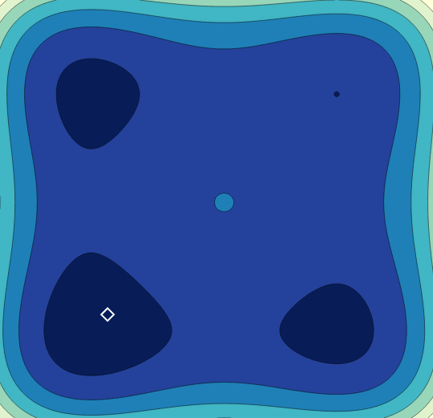
HyperSpace: Parallel exploration of large search spaces
Define the bounds of each hyperparameter search space.
Divide each search space bound into two nearly equal sub-bounds with overlap ɸ, where $\{\text{ɸ}∈ℝ | 0 ≤\text{ɸ}≤1\}$.
Create all possible combinations of hyperparameter sub-bounds to form $2^{D}$ search spaces (hyperspaces) where D is the number of model hyperparameters.
Run Bayesian optimization over each hyperspace in parallel
M. Todd Young, J. D. Hinkle, R. Kannan, A. Ramanathan, HyperSpace: Massively Parallel Bayesian Optimization, Workshop on High Performance Machine Learning, 2018, Lyon, France
Notes:
How does this work?
Hyperpace divides the search space into overlapping bounds – defined by a parameter phi. Then we create all possible combitations of the sub-bounds and create a total of 2^D evaluations. Then we run Bayesian optimization in parallel.

Slide 46
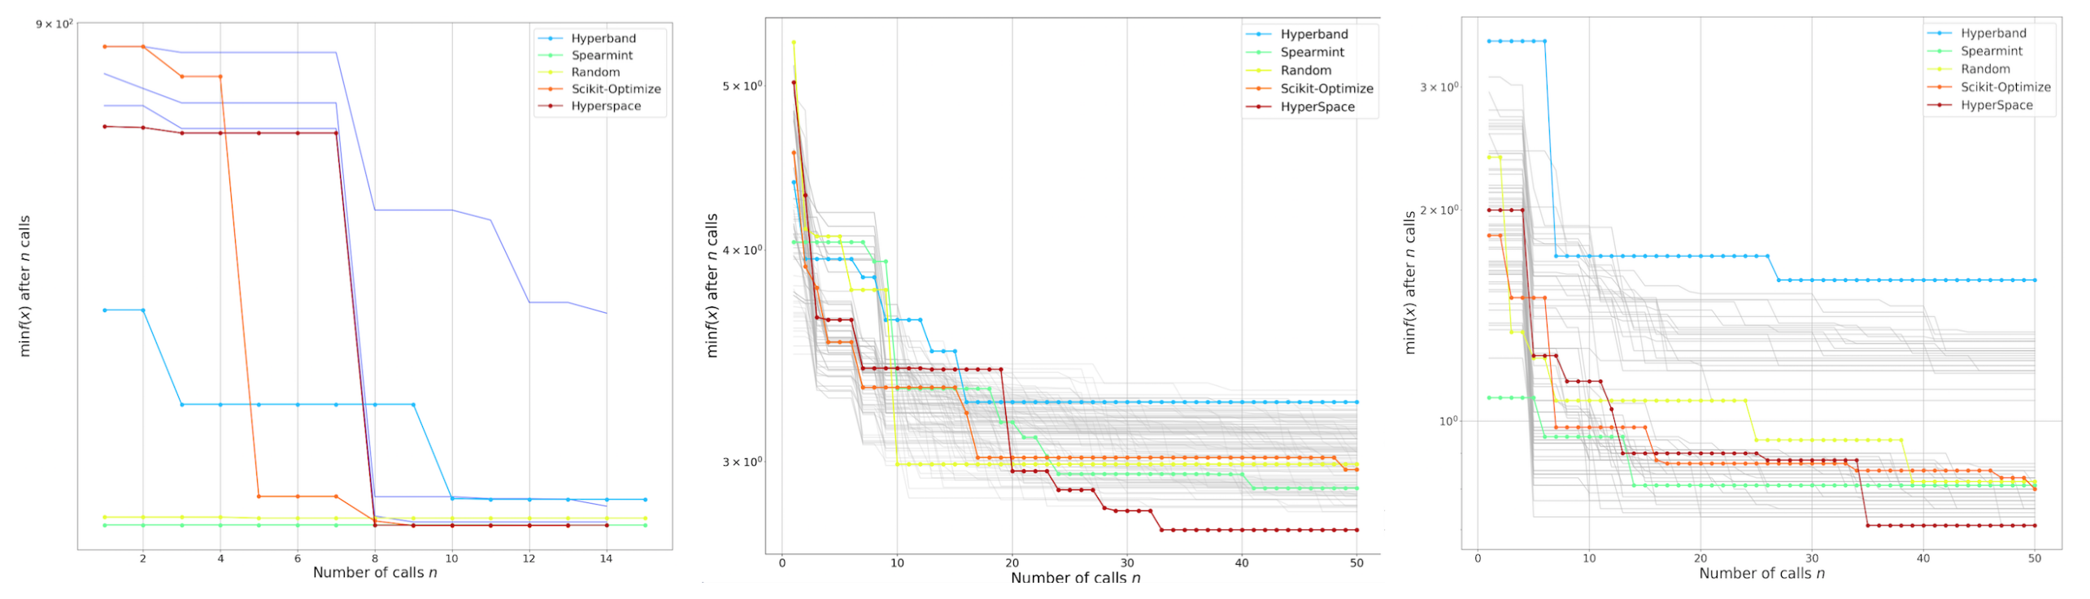
HyperSpace can optimize many different ML/DL approaches
NMF
2 parameters
Gradient Boosted Regression
7 parameters
CNN
7 parameters
HyperSpace can effectively scale across supercomputing resources to reveal how models perform under many unique hyperparameter configurations.
Discovers regions in the hyperparameter search space where models perform well and where they perform poorly
Finds families of solutions where various settings of hyperparameters perform equally well
Opens the possibility of meta learning for hyperparameter optimization (future direction)
M. Todd Young, J. D. Hinkle, R. Kannan, A. Ramanathan, HyperSpace: Massively Parallel Bayesian Optimization, Workshop on High Performance Machine Learning, 2018, Lyon, France
Notes:
HyperSpace can work with a variety of non-deep learning or deep learning models. Here is an example where Hyperspace works with NMF (2 parameters), gradient boosted regression (7) and with a deep CNN (7). It opens up the possibility of many different aspects including discovering regions where models perform better.. Also find families of hyperparametes that serve well and for meta learning across hyperparameter spaces.

Slide 47
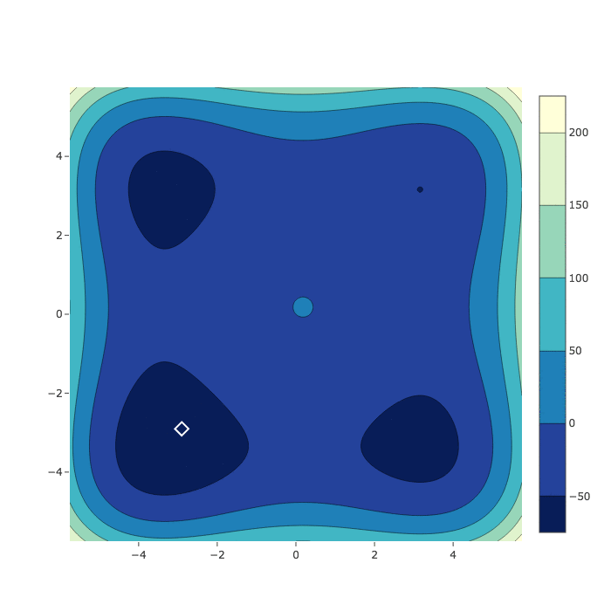
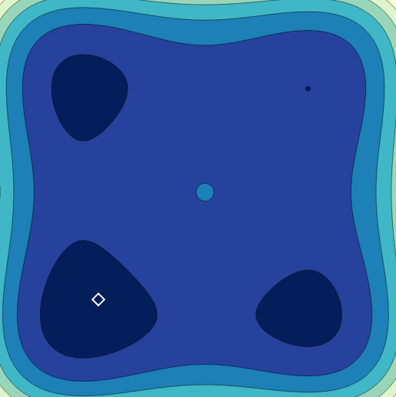
Parallel exploration of large search spaces works better than random/ sequential based optimization
HyperSpace
Random search
SMBO

Slide 48
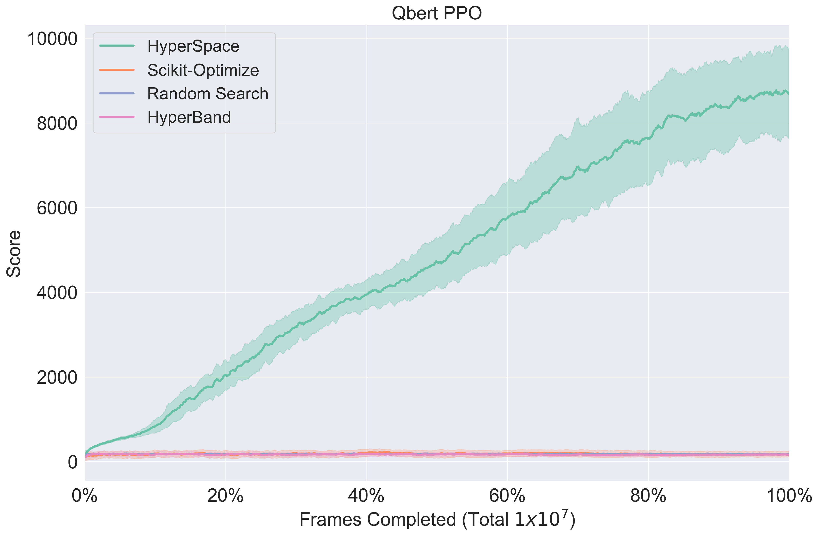
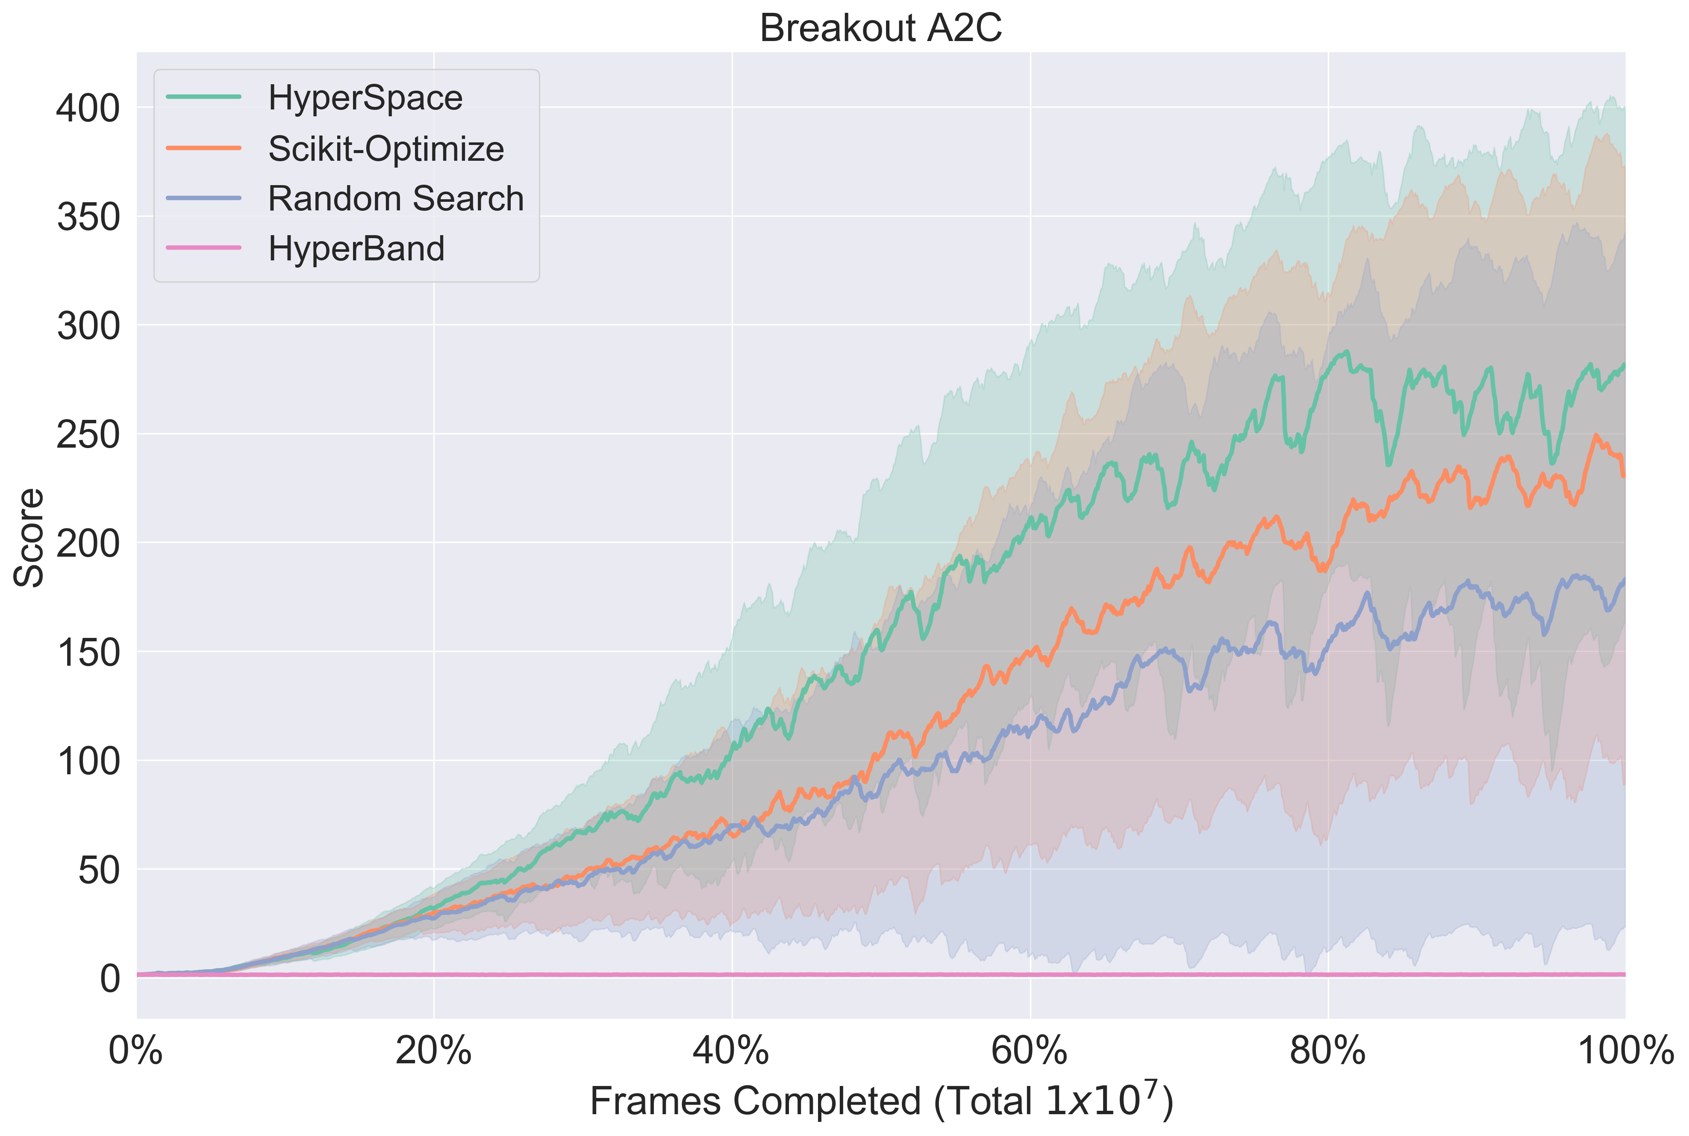
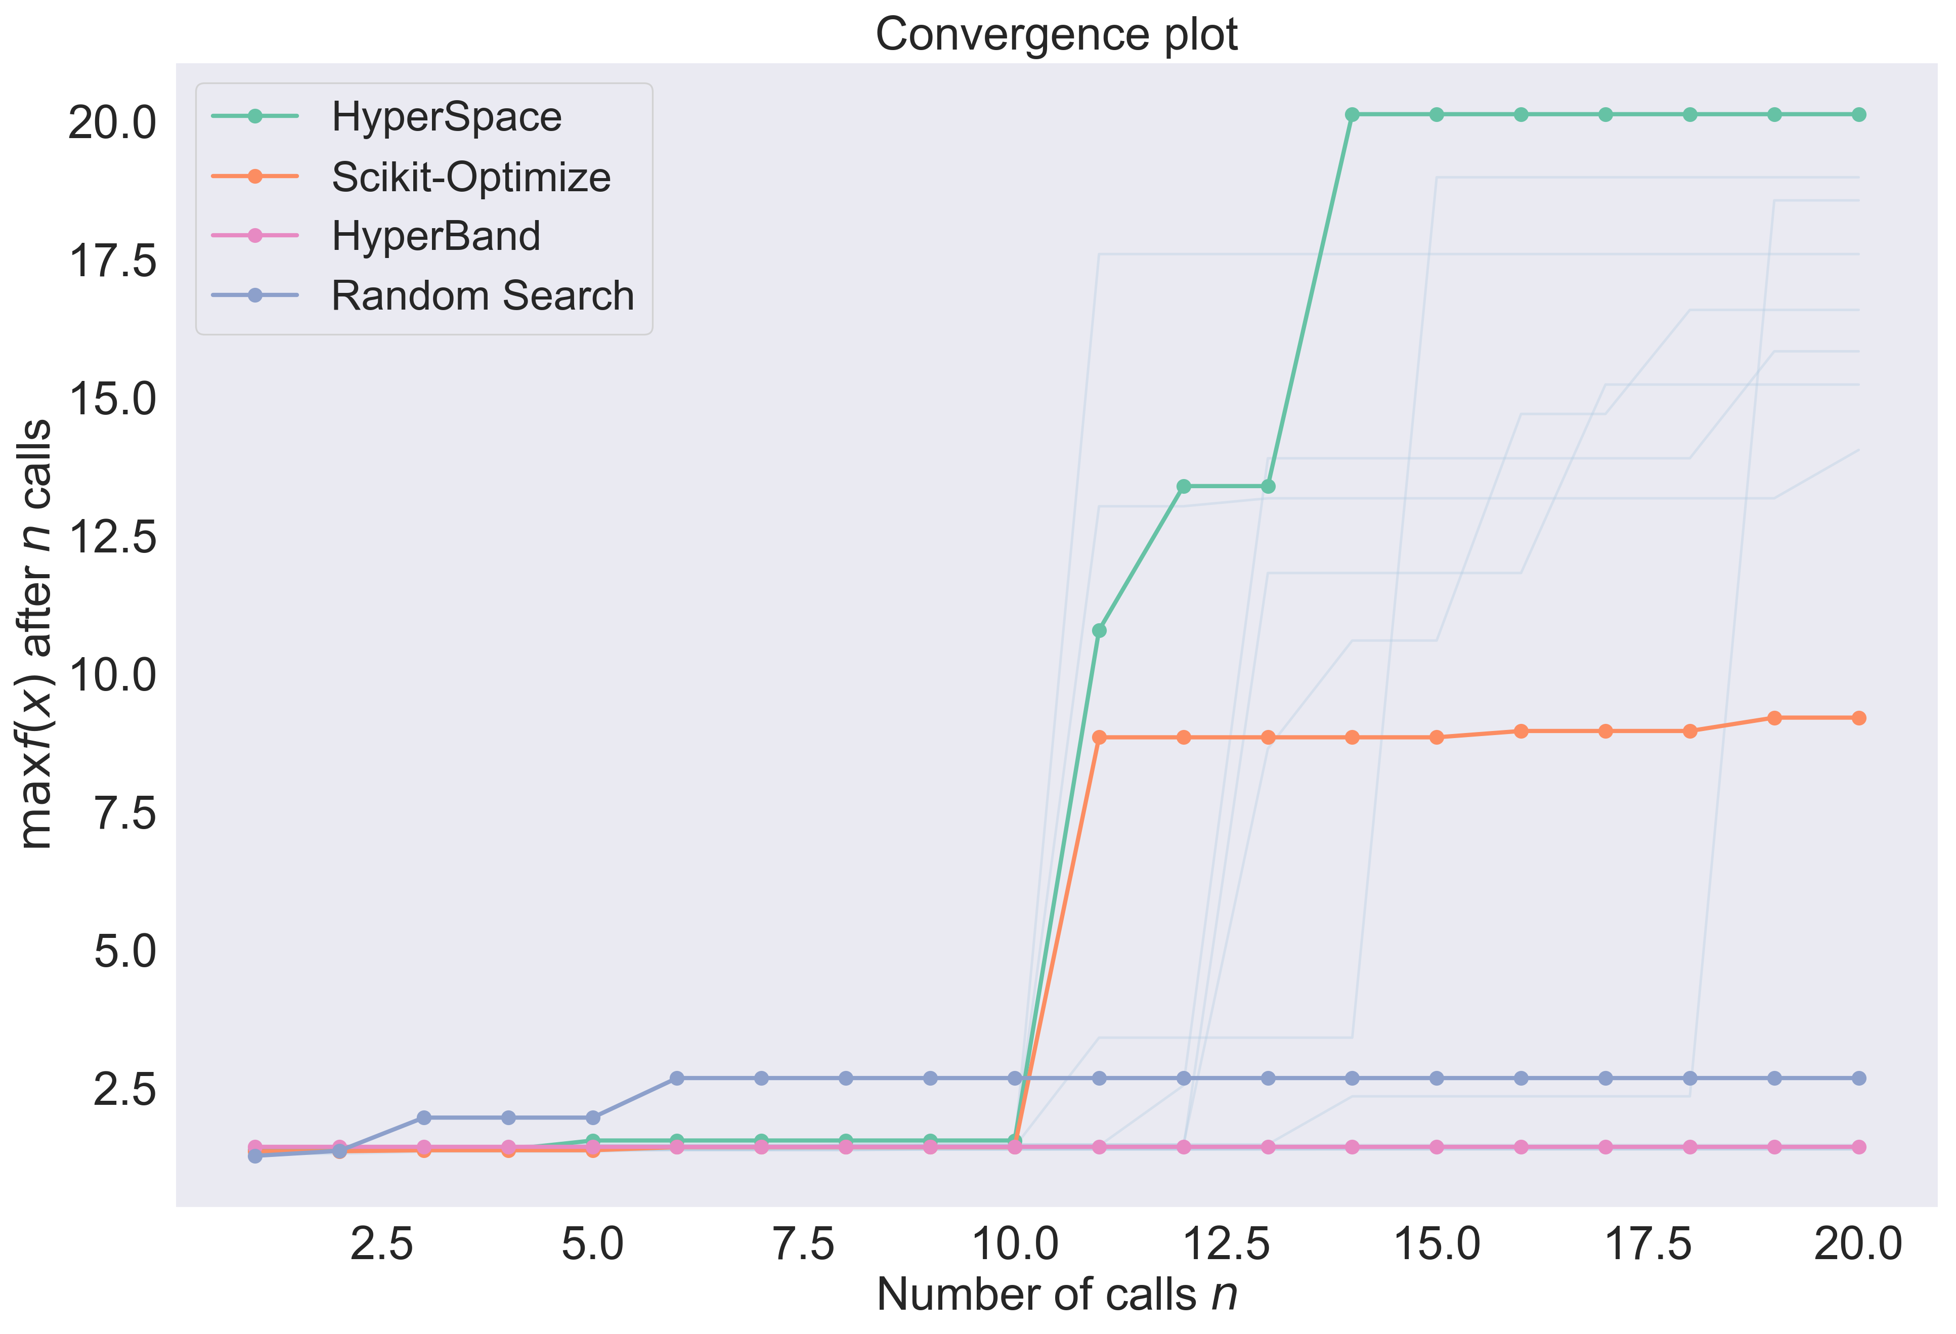
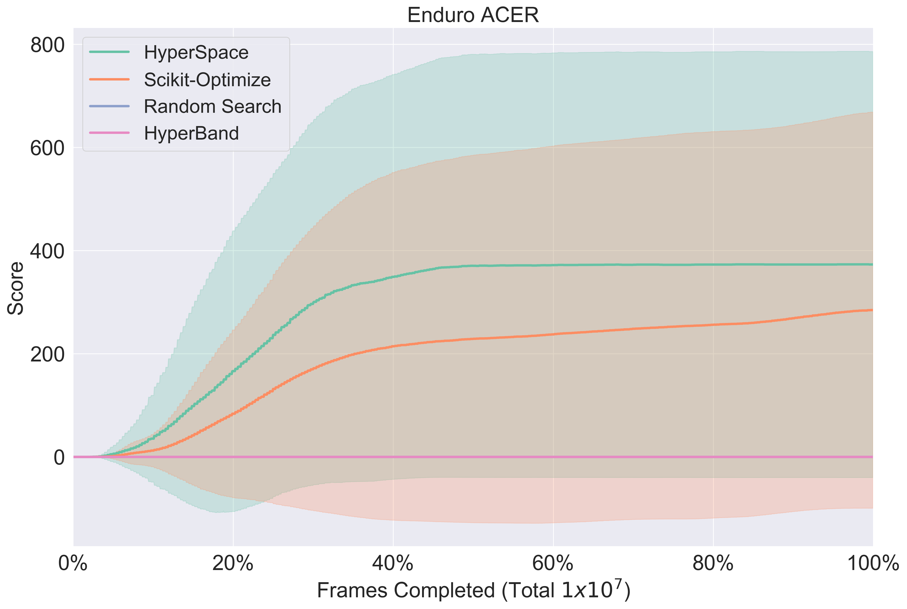
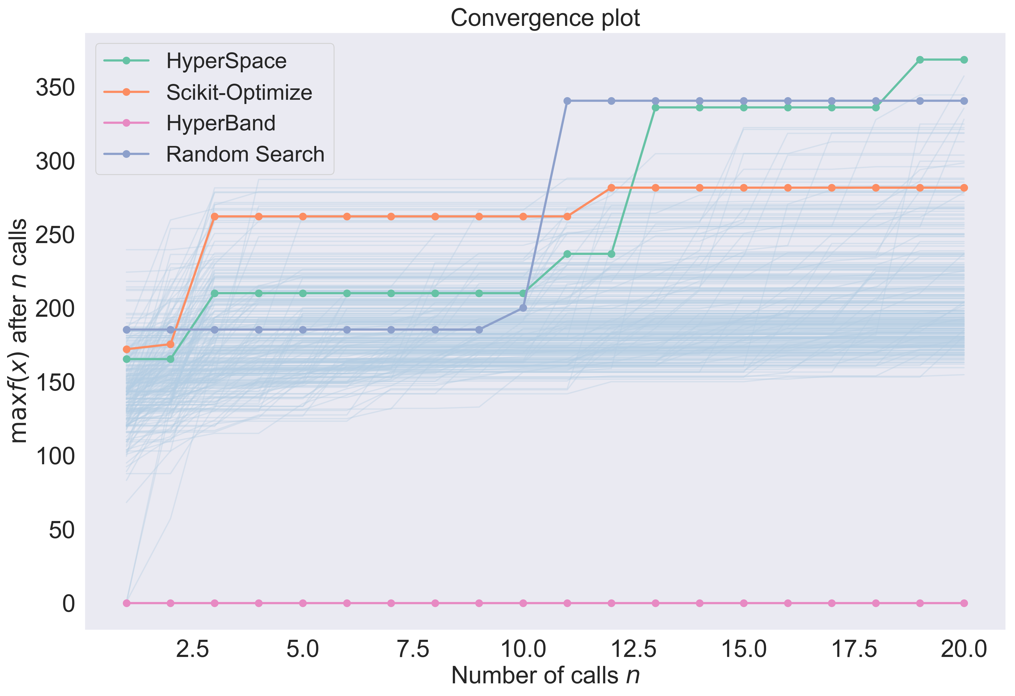
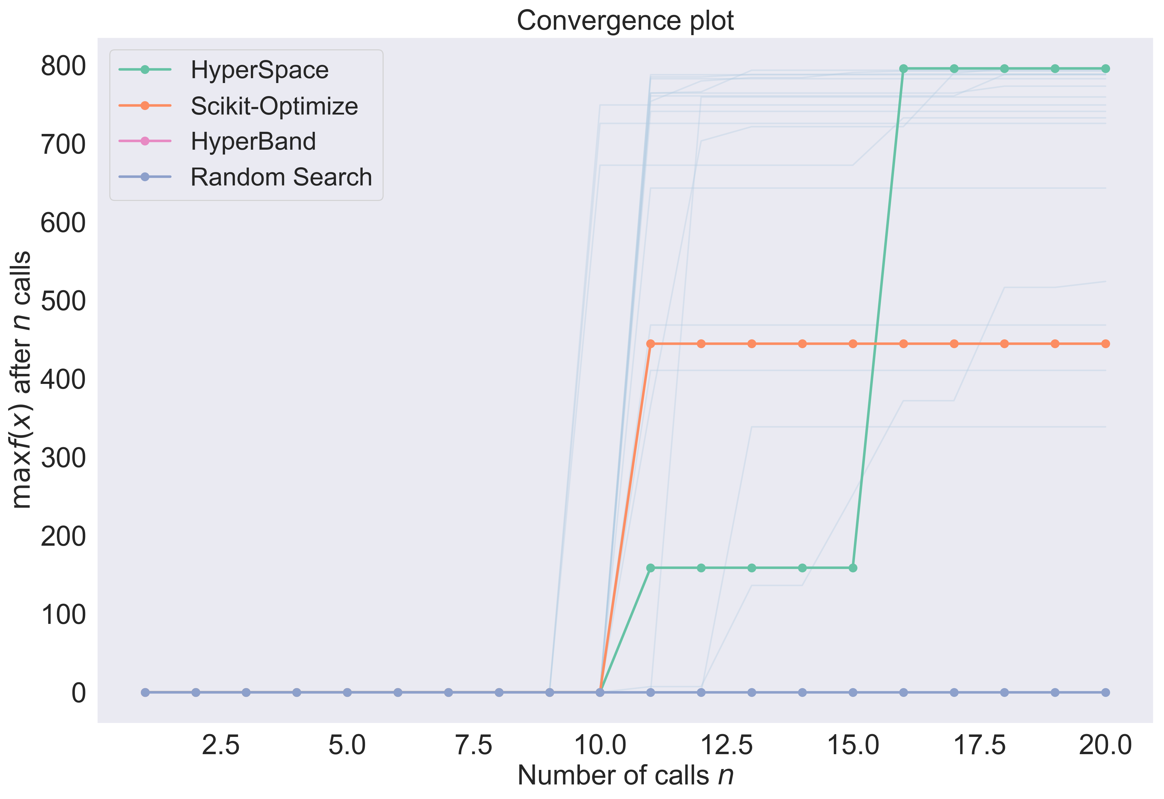
HyperSpace can be used to optimize challenging reinforcement learning approaches
RL ideas are really hard to optimize!
HyperSpace performs better models with rewards that are significantly better for a variety of games

Slide 49
Summary
CANDLE offers a scalable computational infrastructure for deep learning workflows:
Minimal “code” modifications for CANDLE compliance
Novel, scalable approaches for hyper-parameter optimization and distributed learning
Inbuilt tools for UQ for design of robust models
CANDLE applications are diverse:
Genomics,
MD simulations, and
NLP /text analytics
Code and examples will demonstrate ideas further… (so, don’t go anywhere…)

Slide 50
THANK YOU…
Questions/ Comments:
ramanathana@ornl.gov

